Slide 1

Hotel Rating Classification

Slide 2

Contributors :
1.Mr. Sandip Tarachand Mohane 2. Ms. Prajakta Sanjay Bhavsar 3. Mr. Prashant Dnyaneshwar Wagh 4. Mr. Shubham Hitendra Mali
5. Mr. Hritvik ManoharBhadane
6. Ms.Akanksha SanjayMahajan
7. Mr. Soumya Ranjan Patnaik
Group A
Tutor : Mr. Adhvaith

Slide 3
Business objective
Major objective is what are the attributes that travellers are considering while selecting a hotel.
With this manager can understand which elements of their hotel influence more in forming a positive review or improves hotel brand image.

Slide 4
Project architecture
Data Collection
Data Preparation
Exploratory Data Analysis
Modeling
Model Evaluation
Model Deployment
Business Understanding

Slide 5
IMPORT the libraries
Common imports
import pandas as pd
import numpy as np
import matplotlib.pyplot as plt
import seaborn as sns
New imports
import string
import spacy
import nltk
import re
Imports for nlp
from nltk.tokenize import RegexpTokenizer
from nltk.stem import WordNetLemmatizer
from nltk.corpus import stopwords
from textblob import TextBlob
from sklearn.feature_extraction.text import CountVectorizer
from sklearn.feature_extraction.text import TfidfVectorizer

Slide 6
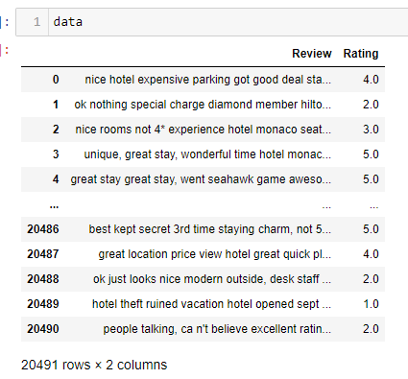
Dataset details
20491 observations and 2 features
No null values
Datatype of ‘Review’ is object and float for ‘Rating’
No duplicate values

Slide 7
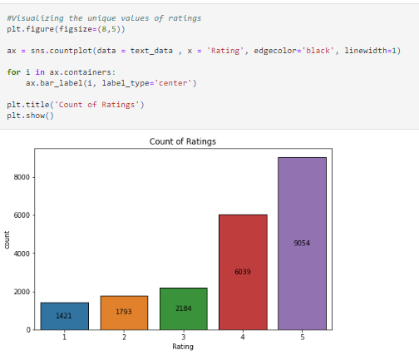
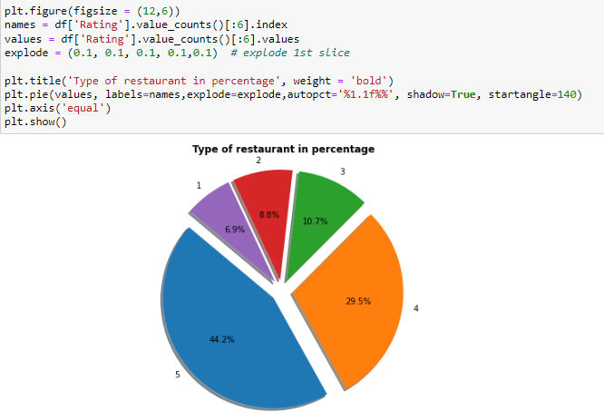
Data visualization

Slide 8
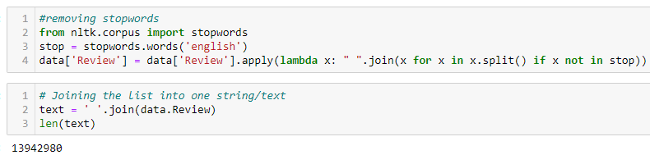
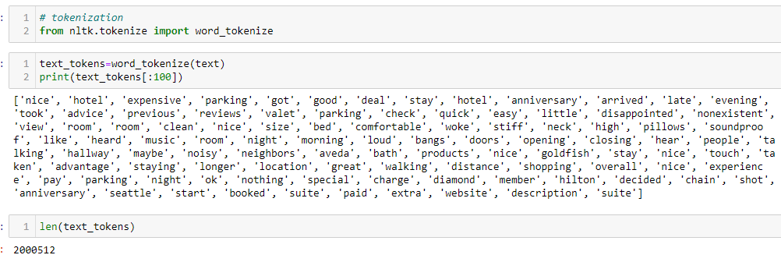
Remove stopwords
TOKENIZATION

Slide 9
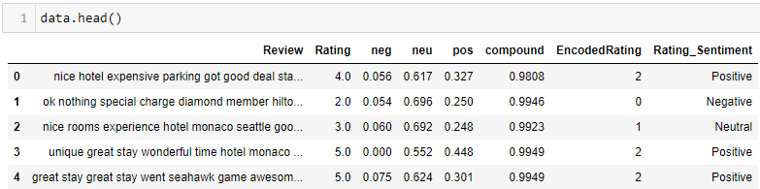
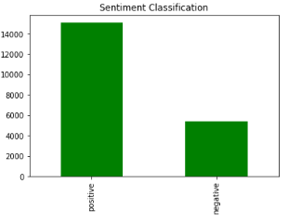
Sentiment analysis

Slide 10
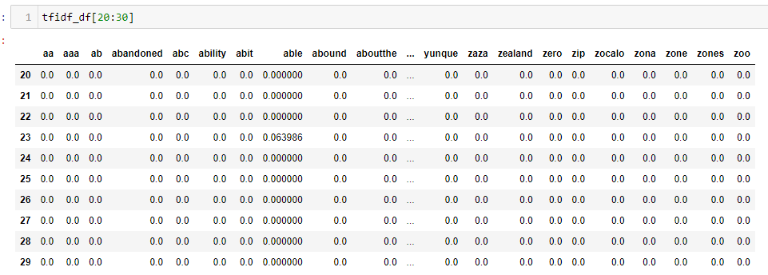
Term frequency inverse document frequency(tfidf)

Slide 11
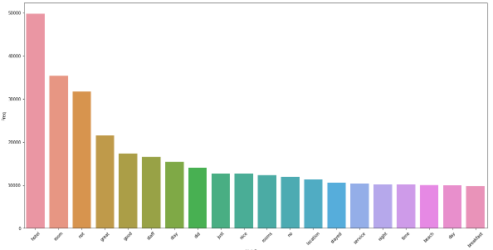
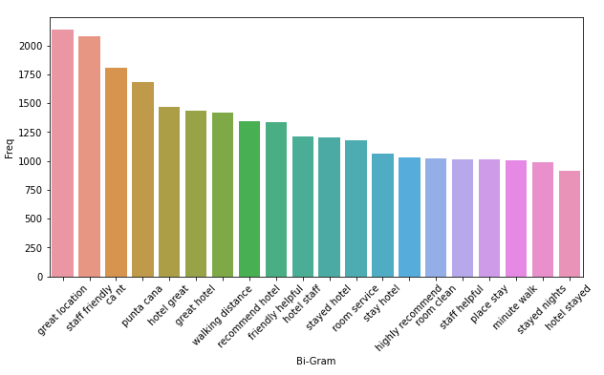
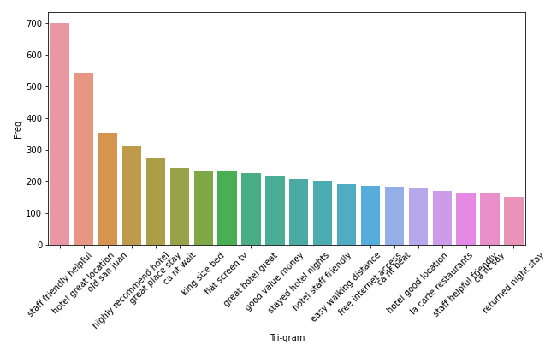
N-gram
Uni-Gram Bi-Gram Tri-Gram

Slide 12
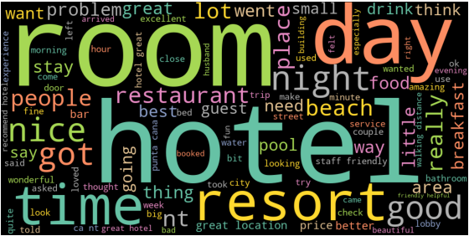
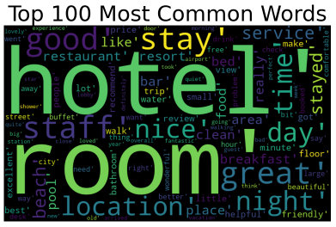
Wordcloud

Slide 13
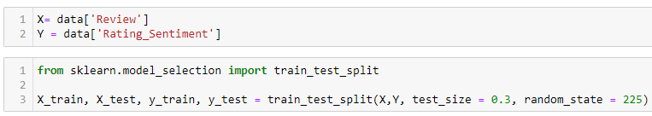

Model Building
Splitting data into train and test
Converting data into vector

Slide 14
Model Evaluation
1. Logistic Regression [LR].
2.Naive Bayes[NB].
3.Support Vector Machine [SVM].
4.Random Forest[RF].
5.Gradient Boost.

Slide 15
Model Results
LR algorithm gives 96% accuracy.
SVM algorithm gives 97% accuracy.
NB algorithm gives 95% accuracy.
Random Forest algorithm gives 95% accuracy.
Gradient Boost algorithm gives 96% accuracy.

Slide 16
Model Deployment using Streamlit method

Slide 17
CHALLENGES FACED
There were large number of values.
Positive number of reviews are more .
So it was difficult to predict negative reviews.
As NLP project the convertion from text to vectors and cleaning process extraction was an hectic.

Slide 18
Conclusion
On the basis of precision, recall, accuracy and F1-score, Logistic Regression and SVM with appropriate parameter settings, performs the best.
We can observe that both SVM and Logistic Regression performs really well as compared to the most complex of these three that is Random Forest.
So we will choose Logistic Regression model to deploy.
It will be interesting to use such a method for sentiment analysis of hotel reviews.

Slide 19

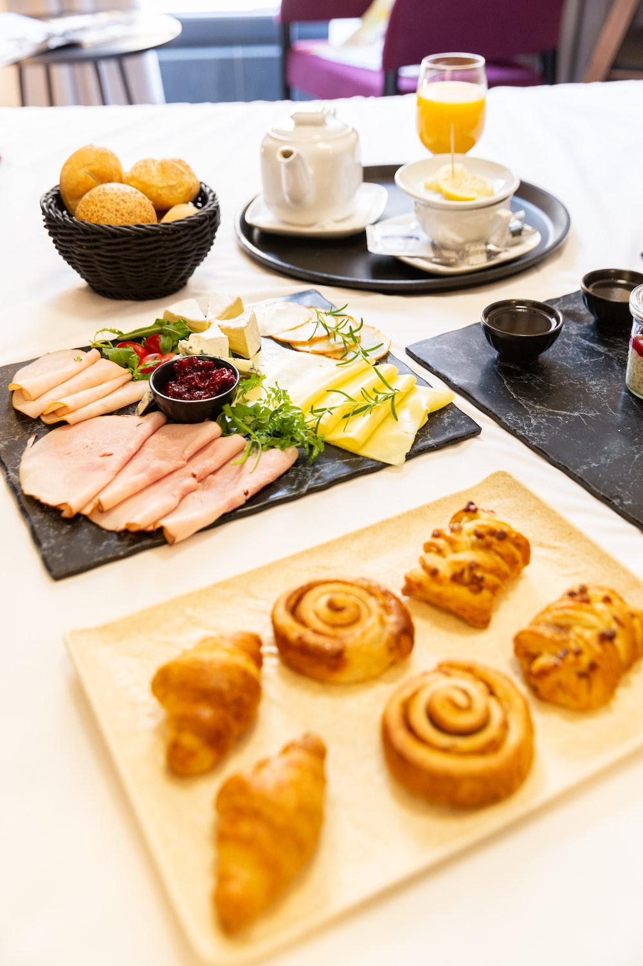

Thanks for your feedback….

